Slide 1
Homework 6 & 7
Weak 2 - Computational Thinking
Group: Thanat, Alp, Mustafa, James, Matt

Slide 2
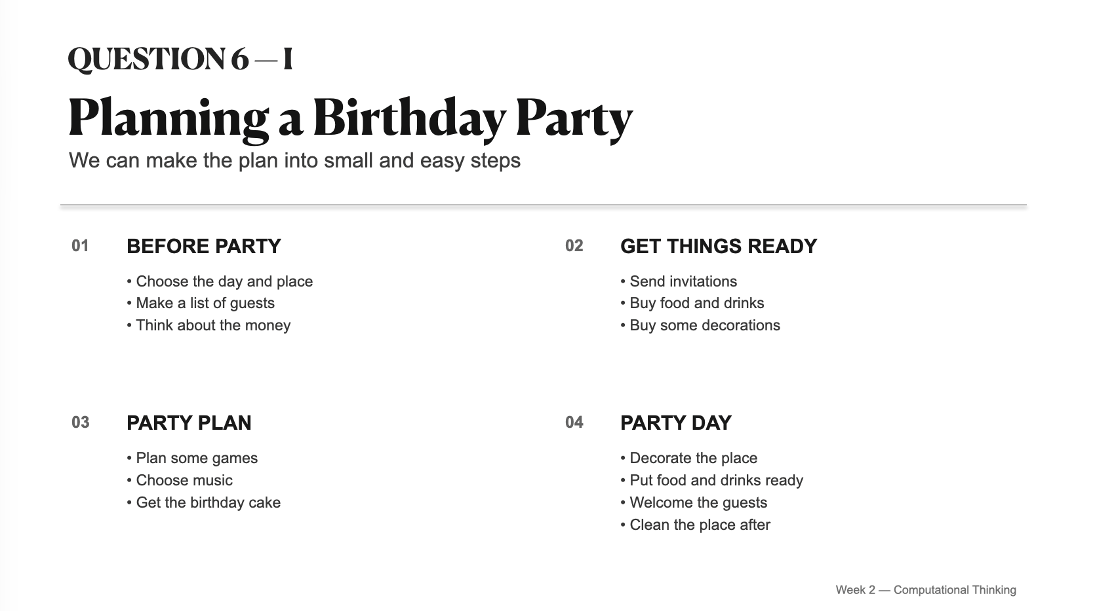

Slide 3
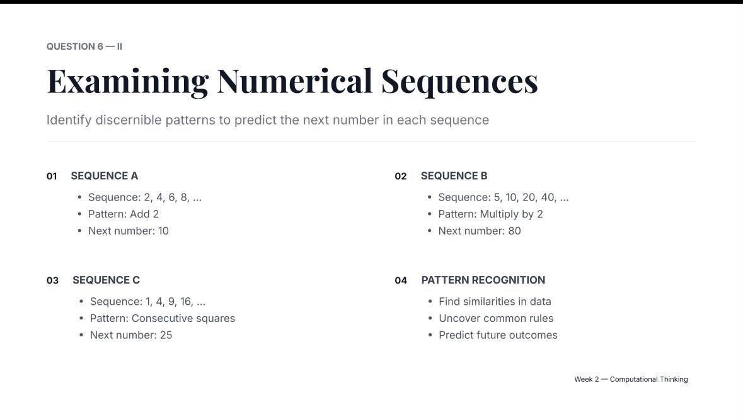

Slide 4
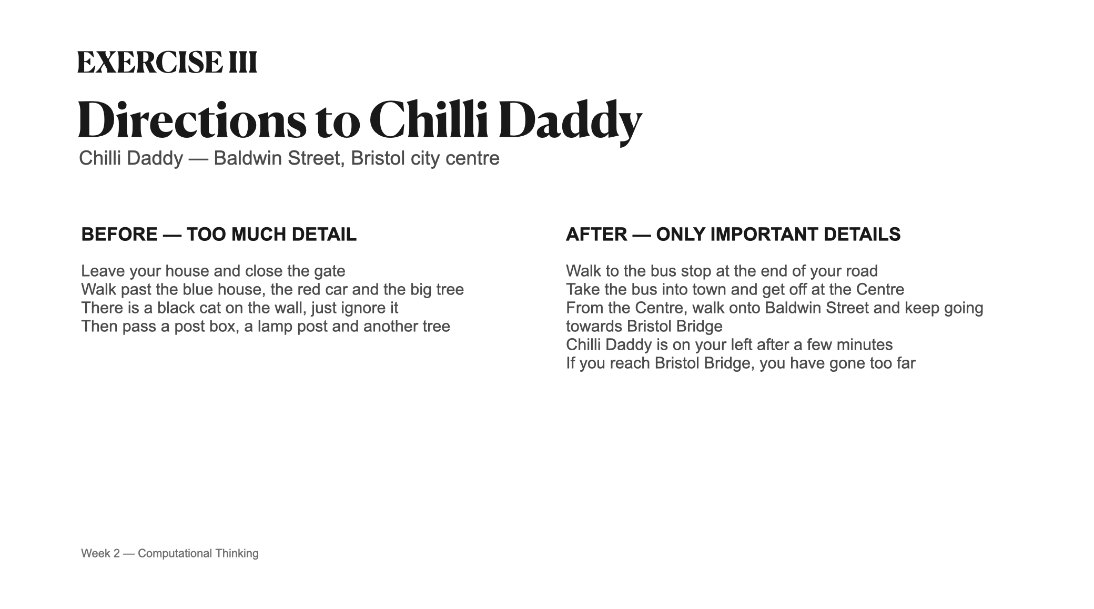

Slide 5
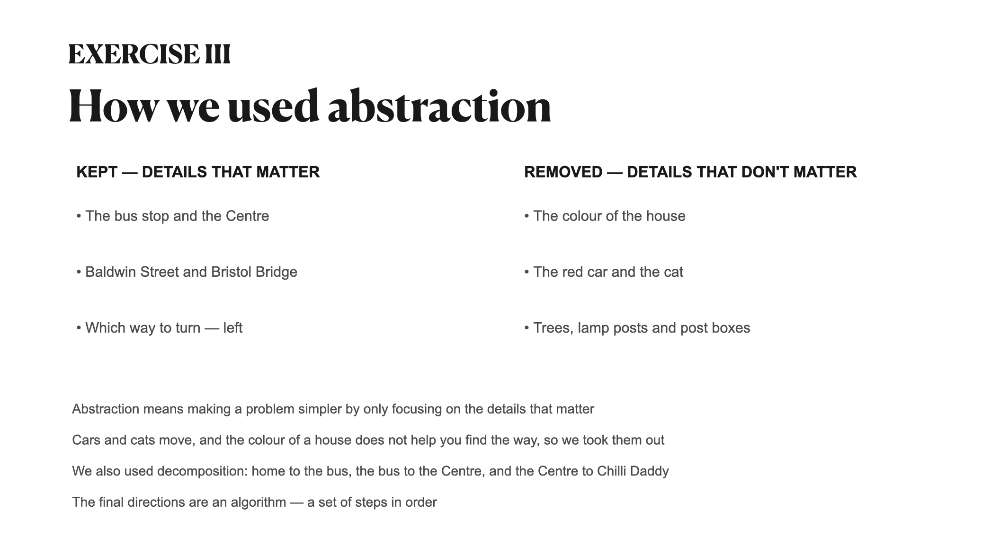

Slide 6
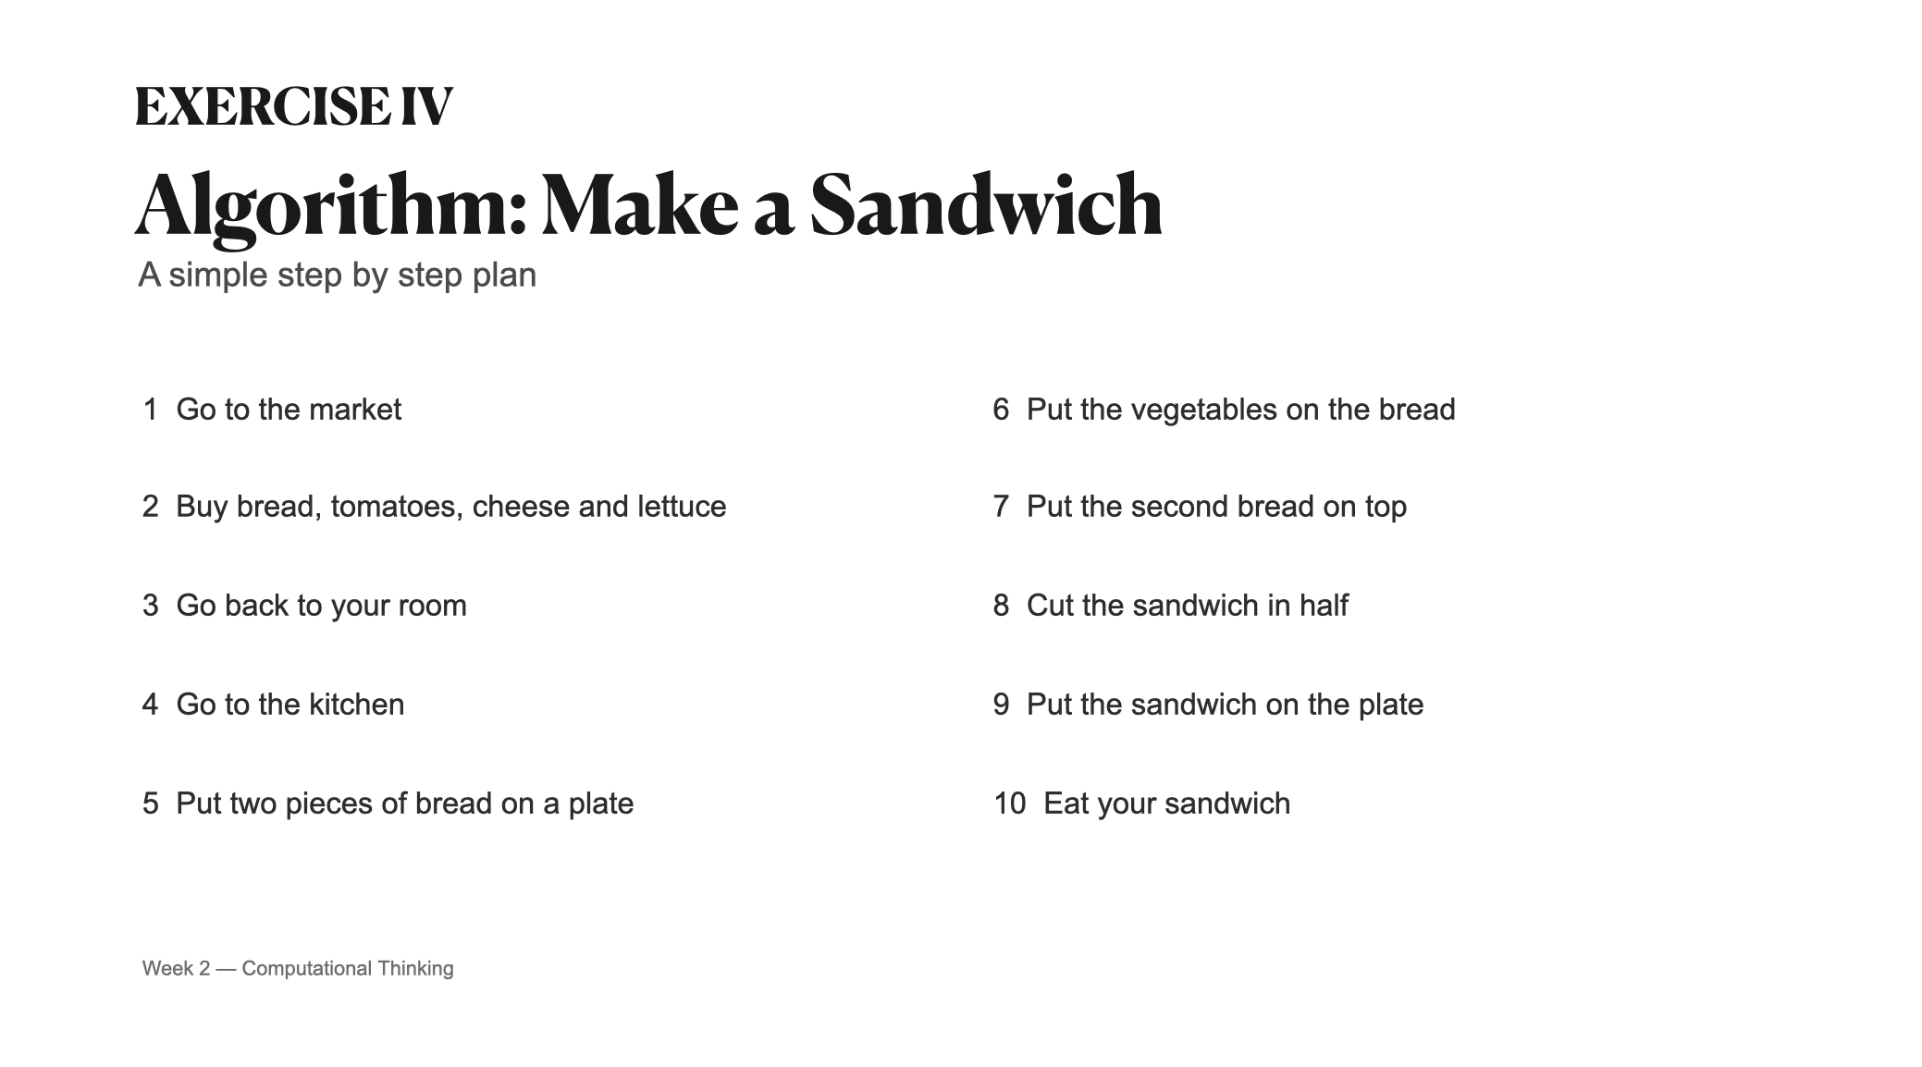

Slide 7
